Slide 1
Welcome
Respected Chief Secretary to Government
GoAP
Dr.T.K.Sreedevi IAS
Commissioner(R&R)
Irrigation & CAD Department.
09.05.2013

Slide 2
Goal
R&R & LA to precede Project completion so as to ensure smooth transition & handing over of the villages to the Requisition Department.
How?
Community mobilisation
Participatory Planning & Implementation
Robust Monitoring
MEaL for concurrent Policy Review

Slide 3
Financial Achievement
Rs. in crores
Year | BE | BRO | EXPENDITURE
2010-11 | 505.65 | 447.57 | 240.30
2011-12 | 491.14 | 447.66 | 274.45
2012-13 | 533.00 | 486.01 | 372.15
2013-14 | 438.22 | 66.08 | 3.25

Slide 4
R&R Activities of Irrigation Projects – a snapshot
No of Projects | 36
Total Villages affected | 550
No.of PAFs affected | 1,41,473
No.of R&R Centres proposed | 508
SES completed | 525
Land acquired for R&R Centres | 234
R&R centers completed | 139
No.of houses contemplated | 1,37,763
No.of houses completed so far | 22,429
No .of Villages Prioritized | 125
No .of Villages Shifted | 54
Notes:
Follow this graph with graphical presentation

Slide 5
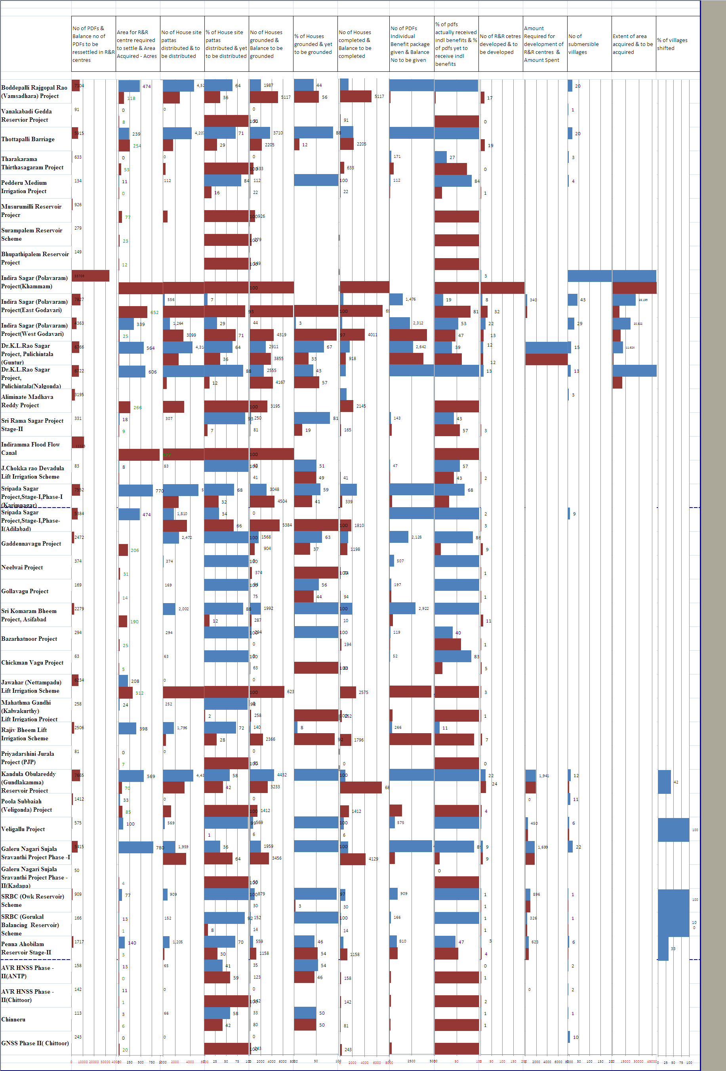

Slide 6
Components of R&R
House site with basic amenities
House grant
Loss of livelihood monitised as wages
Subsistence allowance
Land for land

Slide 7
Functions of District Collector
Approval of list of eligible PDFs
Approval of R&R Action Plan
Approval of works in R&R Centres
Monitoring & Coordinating R&R thru PLMC
Community Mobilization
Establishing linkages for restoring normal rights of the PDFs incl. livelihood
Grievance Redressal

Slide 8
Functions of Project Administrator
Appoint R&R officers(Delegation of Powers)
Conduct SES
Prepare & finalise R&R Action Plan
Assess the infrastructure required in R&R Centres
Execute R&R Action Plan
Payments & Disbursal
Financial Management of R&R
Convene PLMC
Grievance Redressal

Slide 9
Individual Benefits under R&R Policy
Prescribed Item/Issue | Policy - 2005
House site | Rural: 202 Sq.mts Urban: 75 Sq.mts.
Transportation charges | Rs.5000/-
Financial Assistance for cattle shed | Rs.15000/-
Income Generation Grant | Rs.25000/-
House construction grant | Rs.53000 + IAY housing grant.
Allotment of land against land acquired | 2.5 Ha of dry land (or) 1.25 Ha of wet land
Land development Grant | Rs.10000/-
Agriculture production Grant | Rs.5000/-
Agl. Wages for land less | 750 days
Wages for marginal farmers | 500 days

Slide 10
Individual Benefits - Contd…
Wages for small farmers | 375 days
Agriculture labour Wages | 625 days
Subsistence allowance | 240 days
Vulnerable persons (Annuity Policy) | Rs.500/- monthly pension
Members of registered Fishermen co- operative Society/Fishing license holders | 500 days minimum agricultural wages
The families in the project affected areas having fishing rights in the river/pond/dam | Fishing rights in the reservoir
Additional Benefit for ST PDFs For loss of customary rights/usage of forest produce. | 500 days MAW
Additional Benefit for Tribal PAFs resettled outside the district or outside tribal area | 25%

Slide 11
Priority Projects
Dr.K.L.Rao Sagar Pulichintala Project
Guntur & Nalgonda Districts
2. Sripada Yellampally Project
Karimnagar & Adilabad Districts
Date of Impounding of Water – July 2013

Slide 12
Submergence Villages and R&R centres
District | No.of villages under submergence |  | No.of villages under submergence upto min level* |  | No.of R&R Centres identified | No. of R&R Centres developed
Pulichintala Project
Guntur |  | 15 | 8 | 12 |  | 5
Nalgonda |  | 13 | 4 | 13 |  | 6
Yellampally Project
Karimnagar |  | 13 | 6 | 12 |  | 8
Adilabad |  | 9 | 3 | 6 |  | 3
* The minimum amount of water contemplated to store is 25 TMC in
Pulichintala Project and 10 TMC in Yellampally Project.

Slide 13
House sites distributed
District | No.of PDFs Identified | Plots available in the R&R Centres | House site pattas distributed
Pulichintala Project
Guntur | 6447* | 6051 | 4365
Nalgonda | 6722 | 6786 | 5916
Yellampally Project
Karimnagar | 7552 | 7552 | 5124
Adilabad | 5415 | 4900 | 2629
* In Guntur, the original PDFs are 5522; 925 Major sons upto 30-06-2012 are added instead of date of 4(1) Notification.

Slide 14
Status of Housing& Infrastructure
District | No.of PDFs Identified |  | Houses grounded | Houses Completed | Expenditure on Infrastructure (Rs.Crs) | Expenditure on Individual Benefits (Rs. Crs)
Pulichintala Project
Guntur | 6447 | 2858 |  | 1534 | 79.95 | 49.37(44.8%)
Nalgonda | 6722 | 2555 |  | 859 | 19.03 | 48.44(46.4%)
Yellampally Project
Karimnagar | 7552 | 3445 |  | 2789 | 68.96 | 67.39(75.3%)
Adilabad | 5415 | 0 |  | 0 | 26.37 | 73.74(97.5%)
Notes:
Split this slide into two: R&R Infra and Indl Benefits

Slide 15
Pulichintala Project : Issues
Guntur District.
Short fall in Distribution of house site pattas
The number of Major sons is not capped and is increasing
Resolve issue of 448 enjoyers of Kethavaram Endowment lands
Nalgonda District.
Krishna River water scheme (Rs. 22 cr) is a non starter.
Provision of water for construction is a major hurdle.
The issue of 2nd R&R Centre at Nemalipuri and Chintriyala
Pace of work and prioritising schedule of activities is sub optimal : where as 46.4% of individual benefits paid but only 13% of infrastructure works completed.

Slide 16
Yellampally Project : Issues
Karimnagar District.
R&R centers development nascent in case of 4 centers
SES yet to be completed in Konapur village
Housing started in only 5/8 R&R centres
Adilabad District.
Housing yet to start in all R&R centers
House site pattas yet to be distributed in 4 R&R centers
Structure compensation issue to be sorted out for Karnamamidi,
Padthanpally, Gullakota and Rapally Villages.
Land acquisition issues not sorted out : Karnamamidi,
padthanpally, Gullakota and Rapally Villages.
Issues of open land attached to structures to be sorted out

Slide 17
Bottlenecks in R&R
Policy -
Date of implementation of benefits to major daughters
50% land acquisition cap w.r.t. small and marginal farmers.
Need to revise housing grant.
Focus on Livelihoods
Notes:
Ref:
G O Ms No 21, Housing (RH A1) Dept, dt 02.07.2011
Lr No 1205/CRR/SRO/PT&HS, 2009, Dt: 30.08.2011, 02.11.2012 and 13.12.2012 of Commissioner (R & R)

Slide 18
Bottlenecks in R&R Contd..
Implementation –
Issues in the establishment of Infrastructure and basic amenities at the R&R center
Phasing of distribution of Individual Benefits.
Selection of R&R Centre – Question of consent of the PDFs and proximity to displaced village
Relocation of villages to be prioritized based on contour levels.
Linkages -
Issues emanating in the transition from the submersible village to the R&R center.
Notes:
Ref:
G O Ms No 21, Housing (RH A1) Dept, dt 02.07.2011
Lr No 1205/CRR/SRO/PT&HS, 2009, Dt: 30.08.2011, 02.11.2012 and 13.12.2012 of Commissioner (R & R)

Slide 19
Important Action Points
Community Mobilization through Gram Sabhas
Expedition of issue of House sites & grounding of houses.
Capping of SES including major sons upto 4 (1) notification.
Need to revisit APL norms
Regular PLMC meetings
Grievance Redressal Cell
Establishment of Linkages with other Departments which
act as pull factors.
Contingency plan in place.

Slide 20
Thank You

